Slide 1
ACCOUNTING SYSTEM
Accountant and Delegate's Module (Module 8)
Mohd Mazlan Bin Mohd Nor (177132) Muhammad Nabil Irfan Bin Abdul Malek (178413) Muhamad Adam Fakrullah Bin Nik Mohamad (179660) Haimanul Iman Bin Unvar Rahman (179631)

Slide 2
Introduction
The objective of this module is to:
managing the expenses and income of the company’s account
record the details about the cash flow in and out of the company’s account
keep track the cash flow of the company
The scope of this module is wide because any qualified accountant and auditor can register into this application

Slide 3
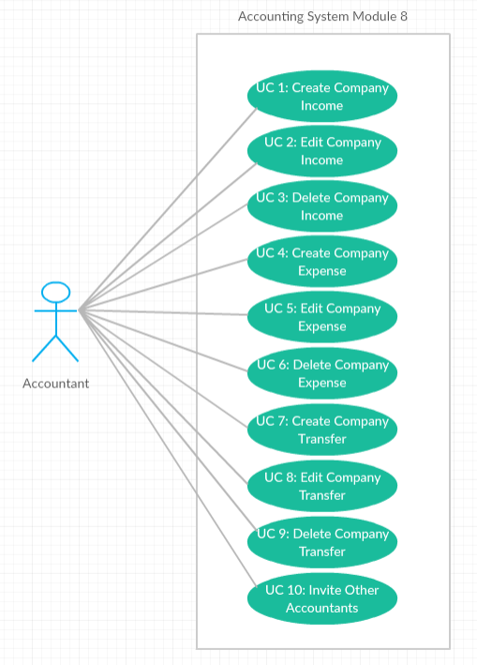
Use Case Diagram

Slide 4
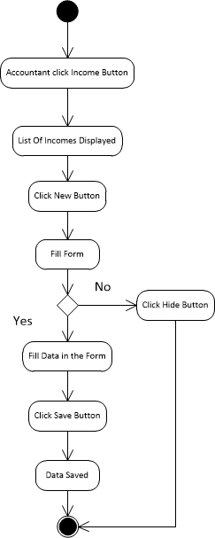
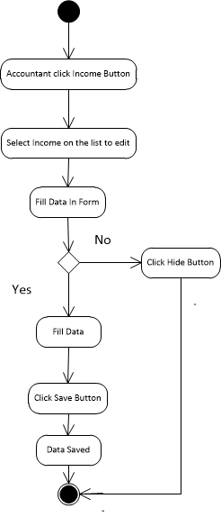
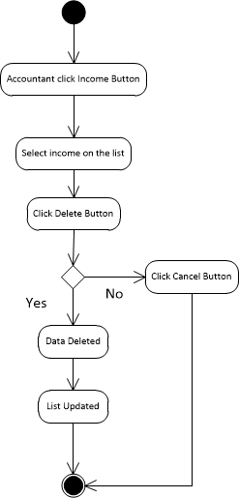
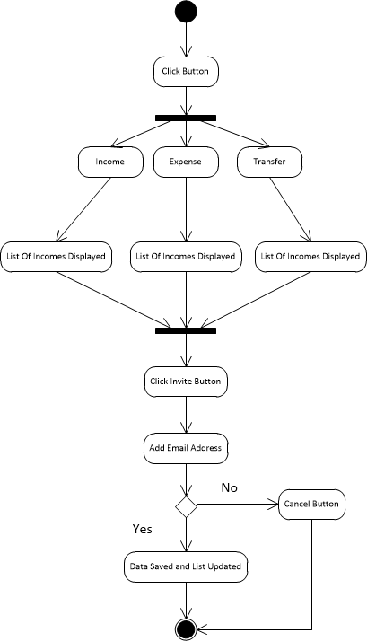
Activity Diagram

Slide 5
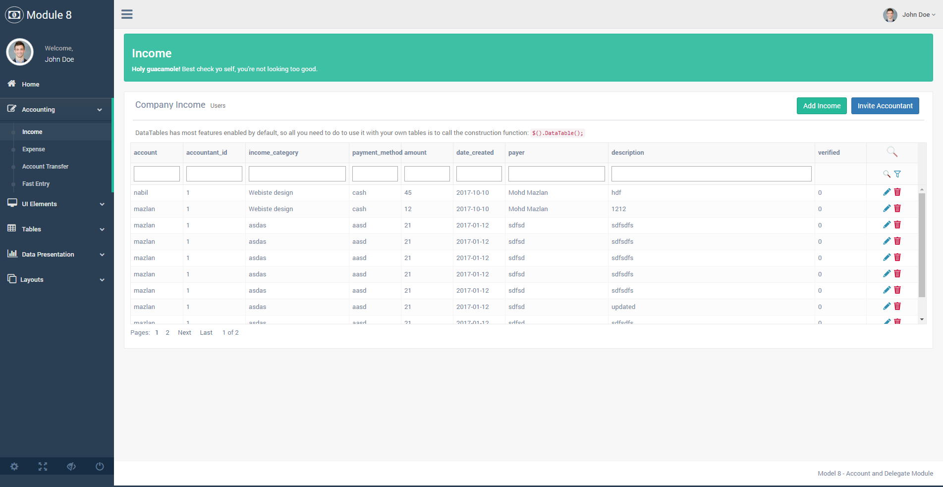
Income

Slide 6
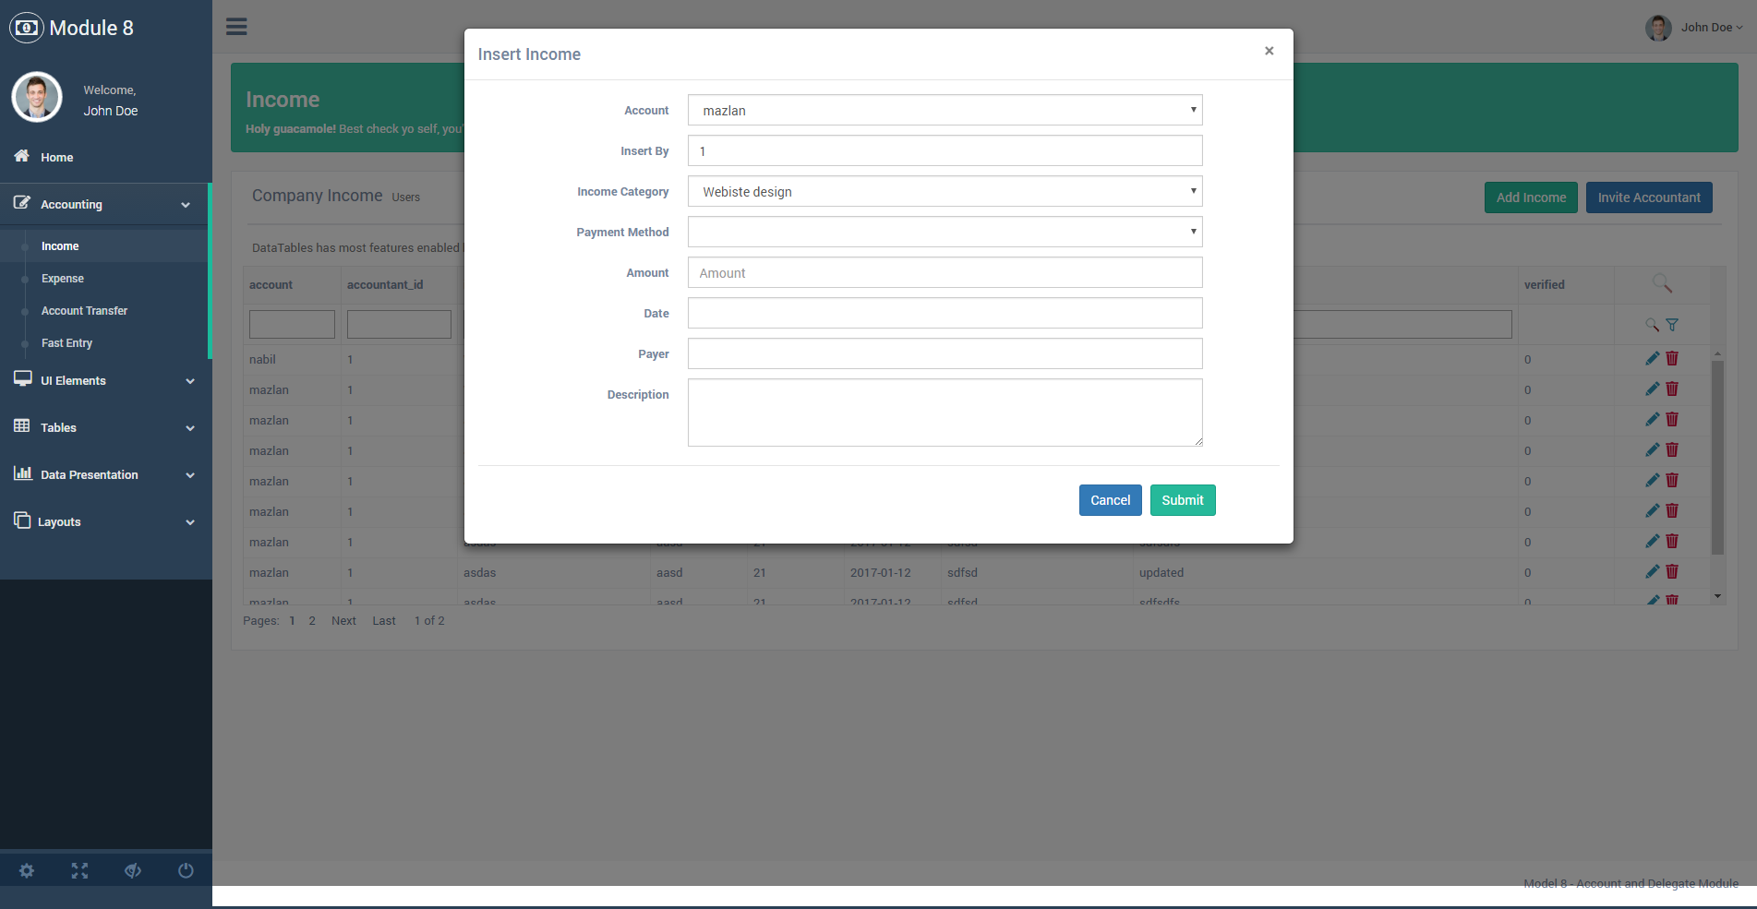
Add Income

Slide 7
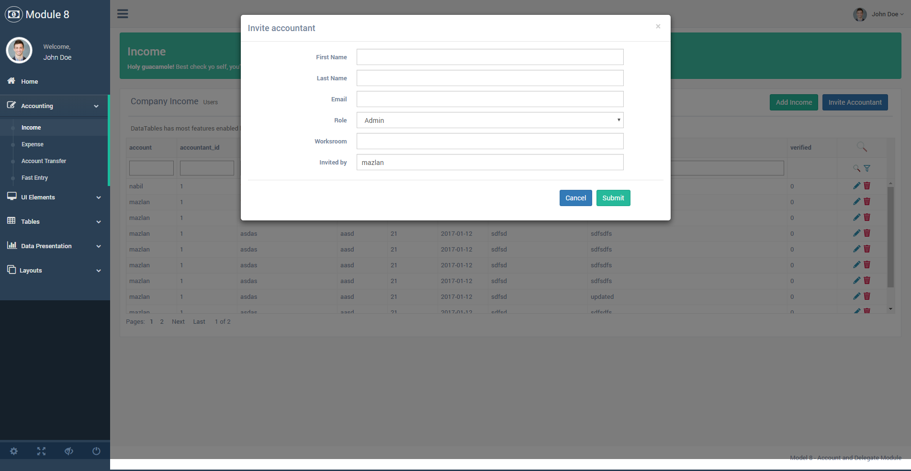
Invite Other Accountant

Slide 8
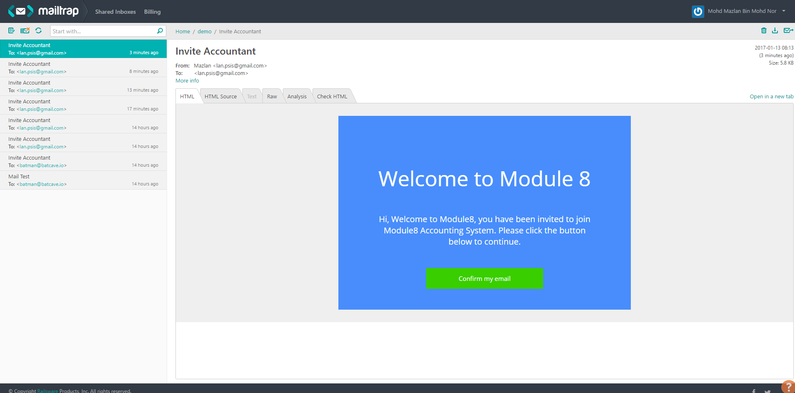
Invited

Slide 9
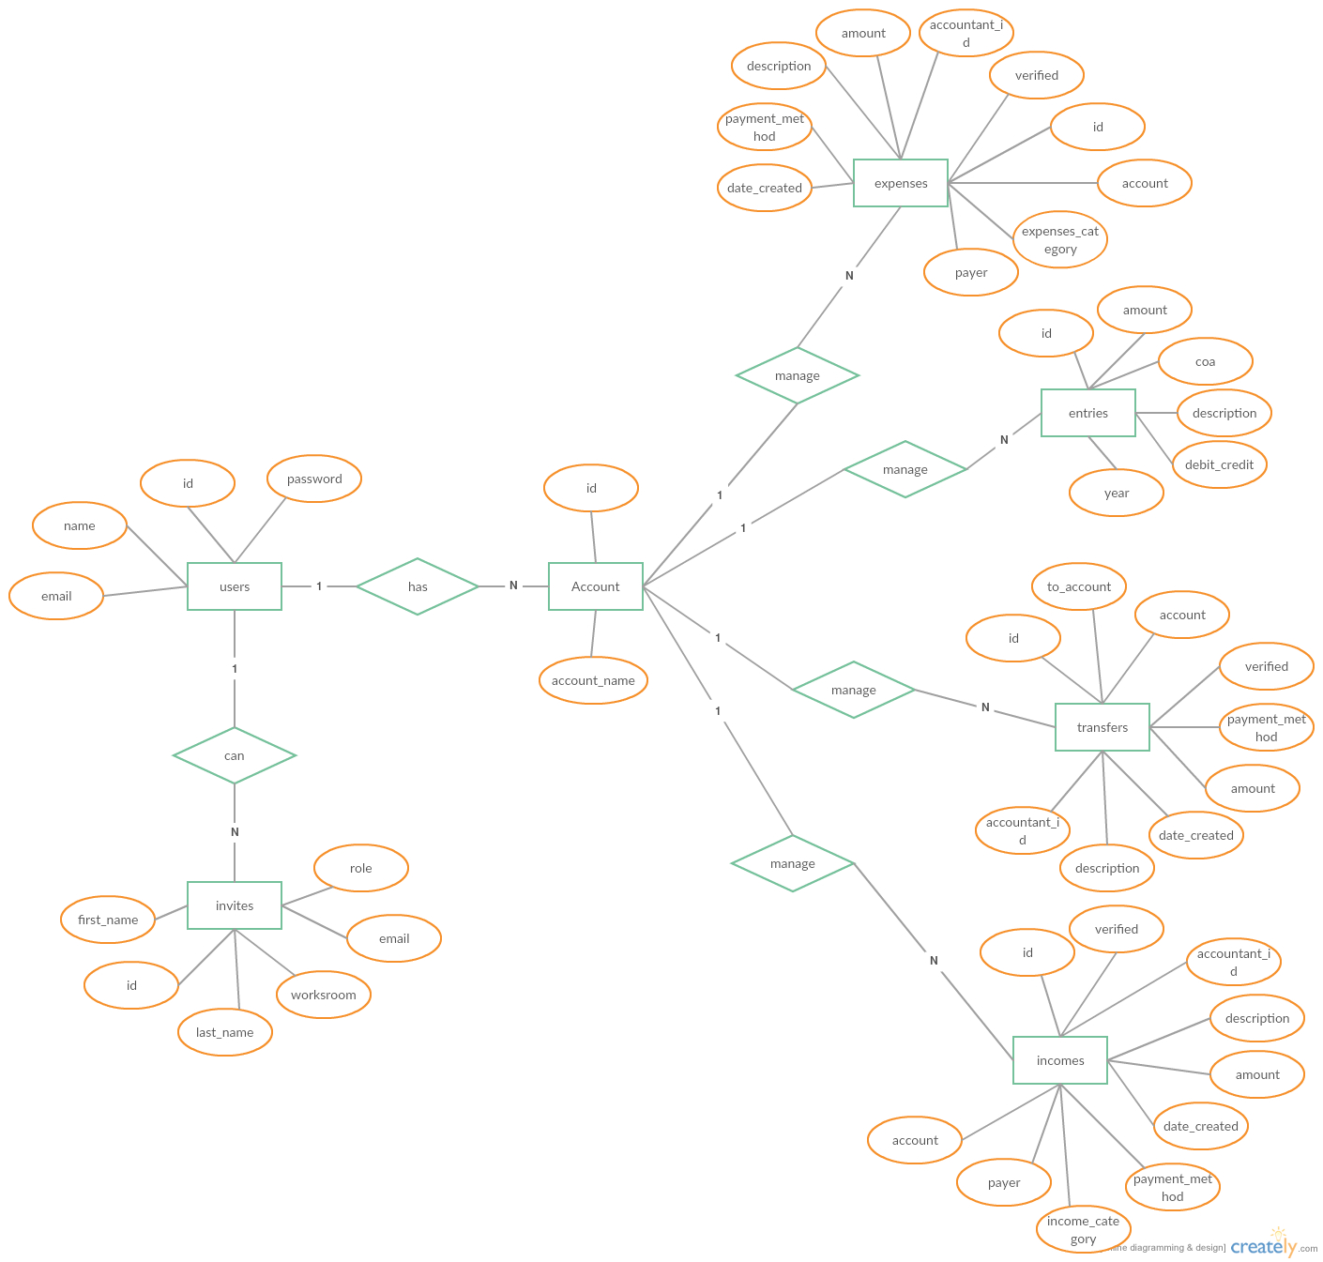
ERD

Slide 10
Architecture Design
We use Model - View - Controller architecture pattern because of its high availability and is widely used in many mobile app development framework
Each layer is really maintainable, testable, easy to assign separate “roles” and easy to update and enhance layers separately
Each components of MVC is highly reusable and it can be used by another module of the system

Slide 11
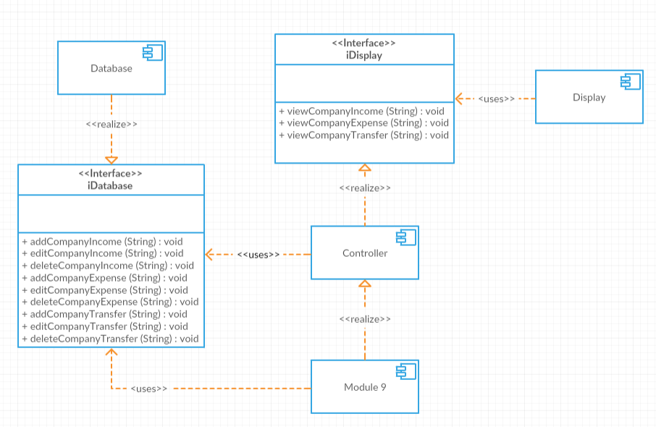
Architecture Design

Slide 12
Demo

